Slide 1
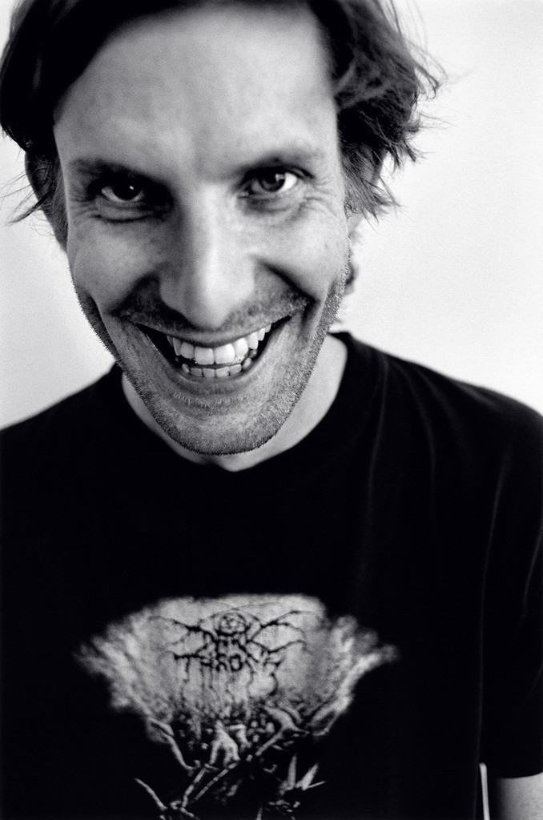
Cory Arcangel

Slide 2
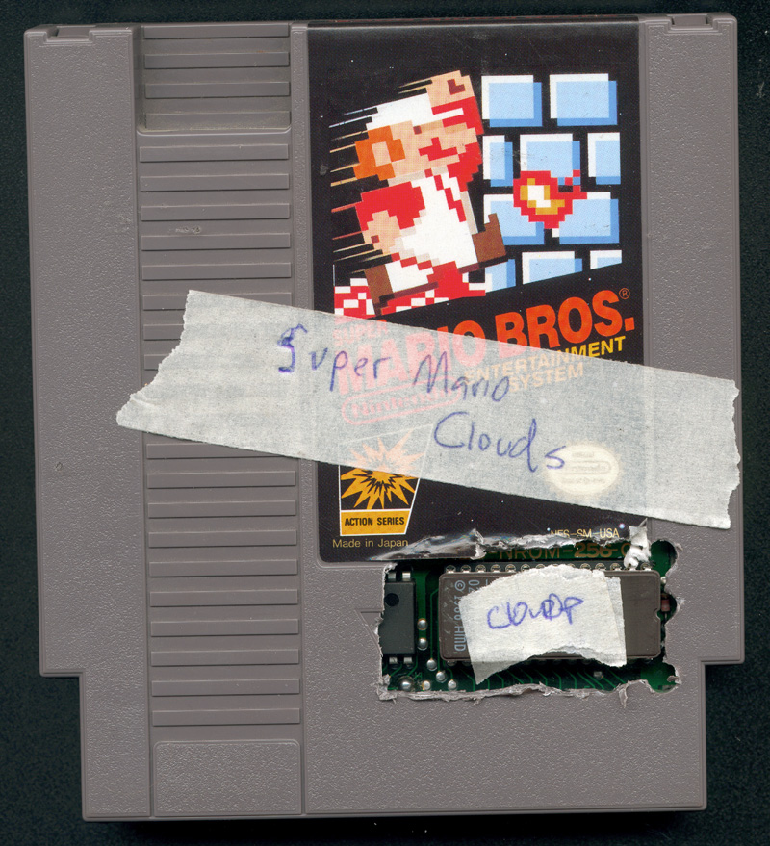

Slide 3


Slide 4
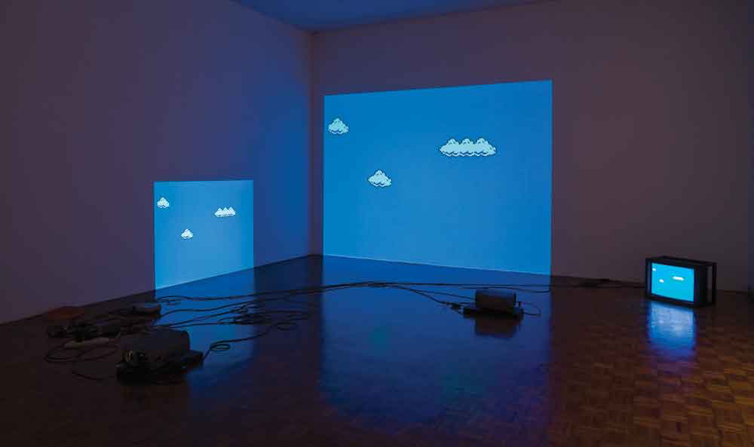

Slide 5
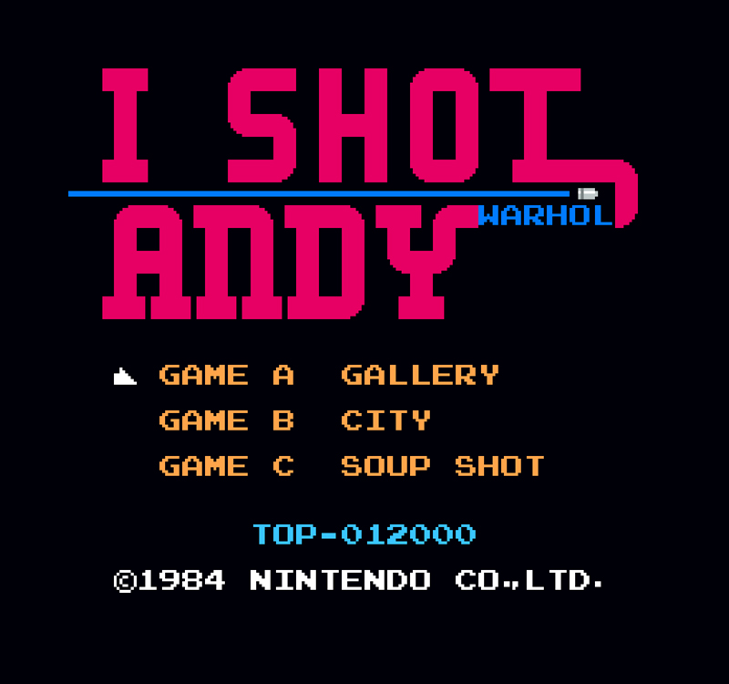

Slide 6
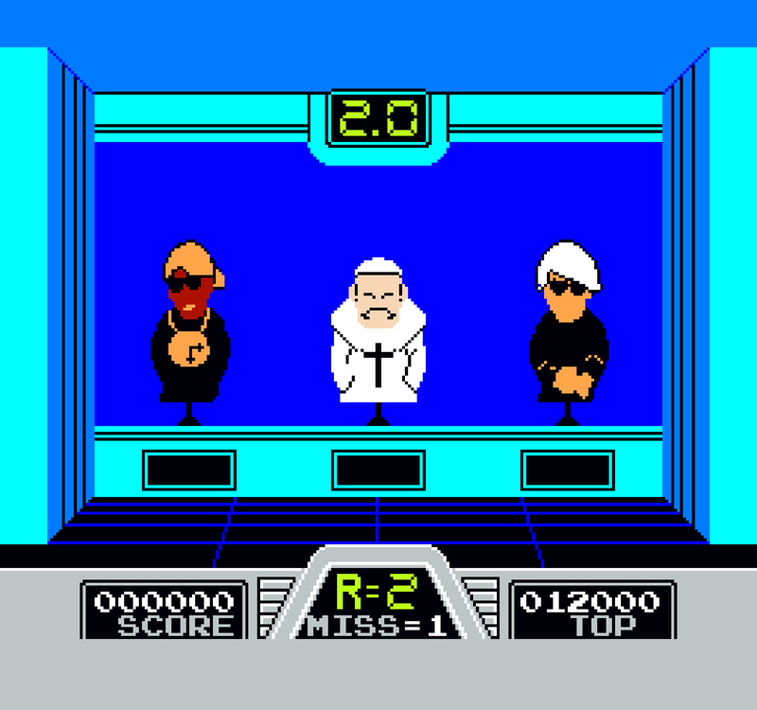

Slide 7
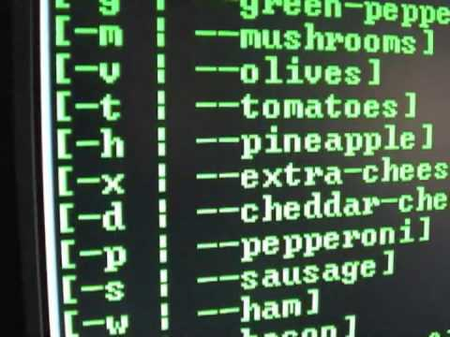

Slide 8
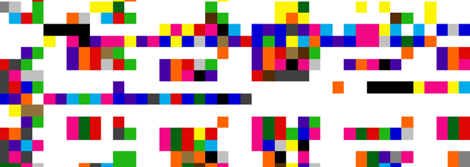

Slide 9
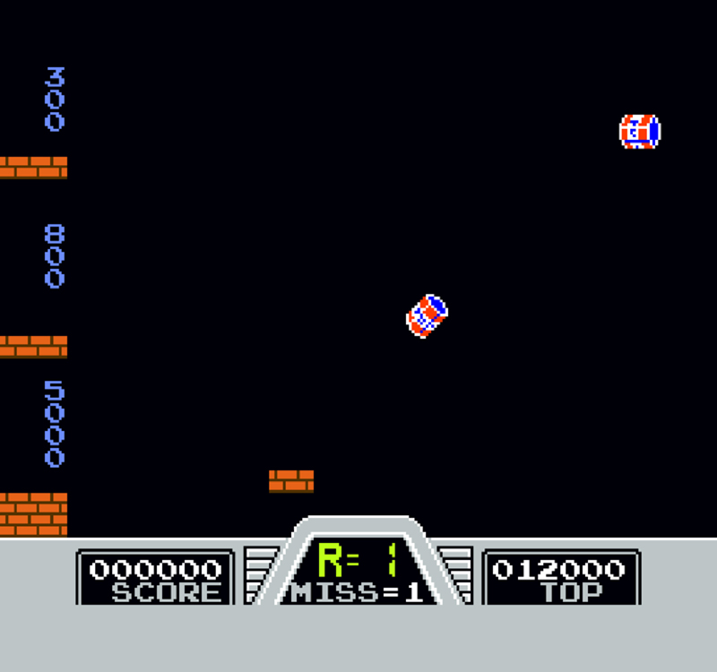

Slide 10
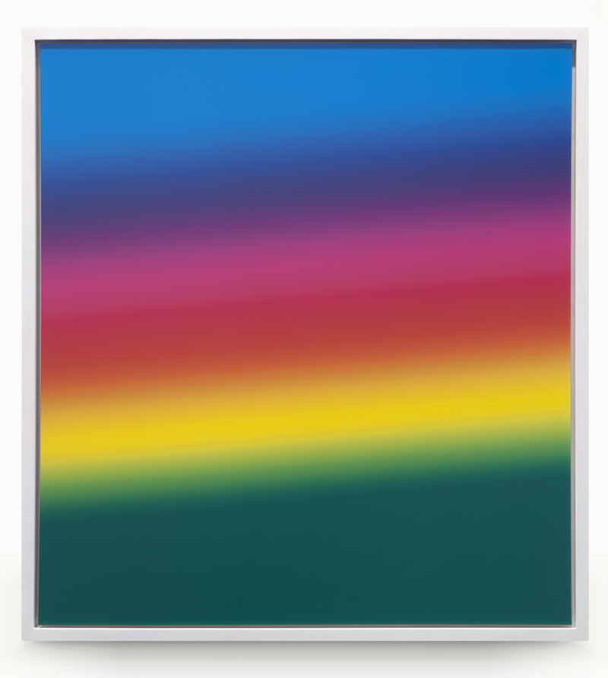

Slide 11
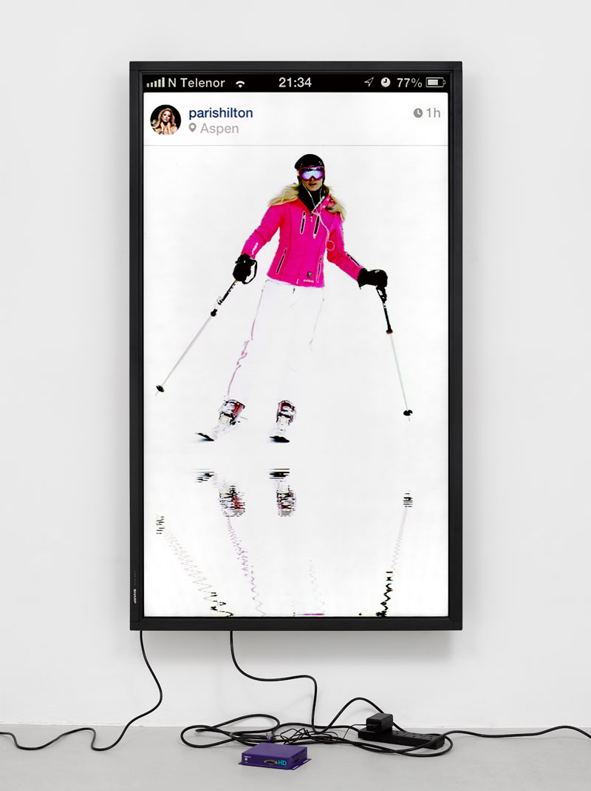

Slide 12
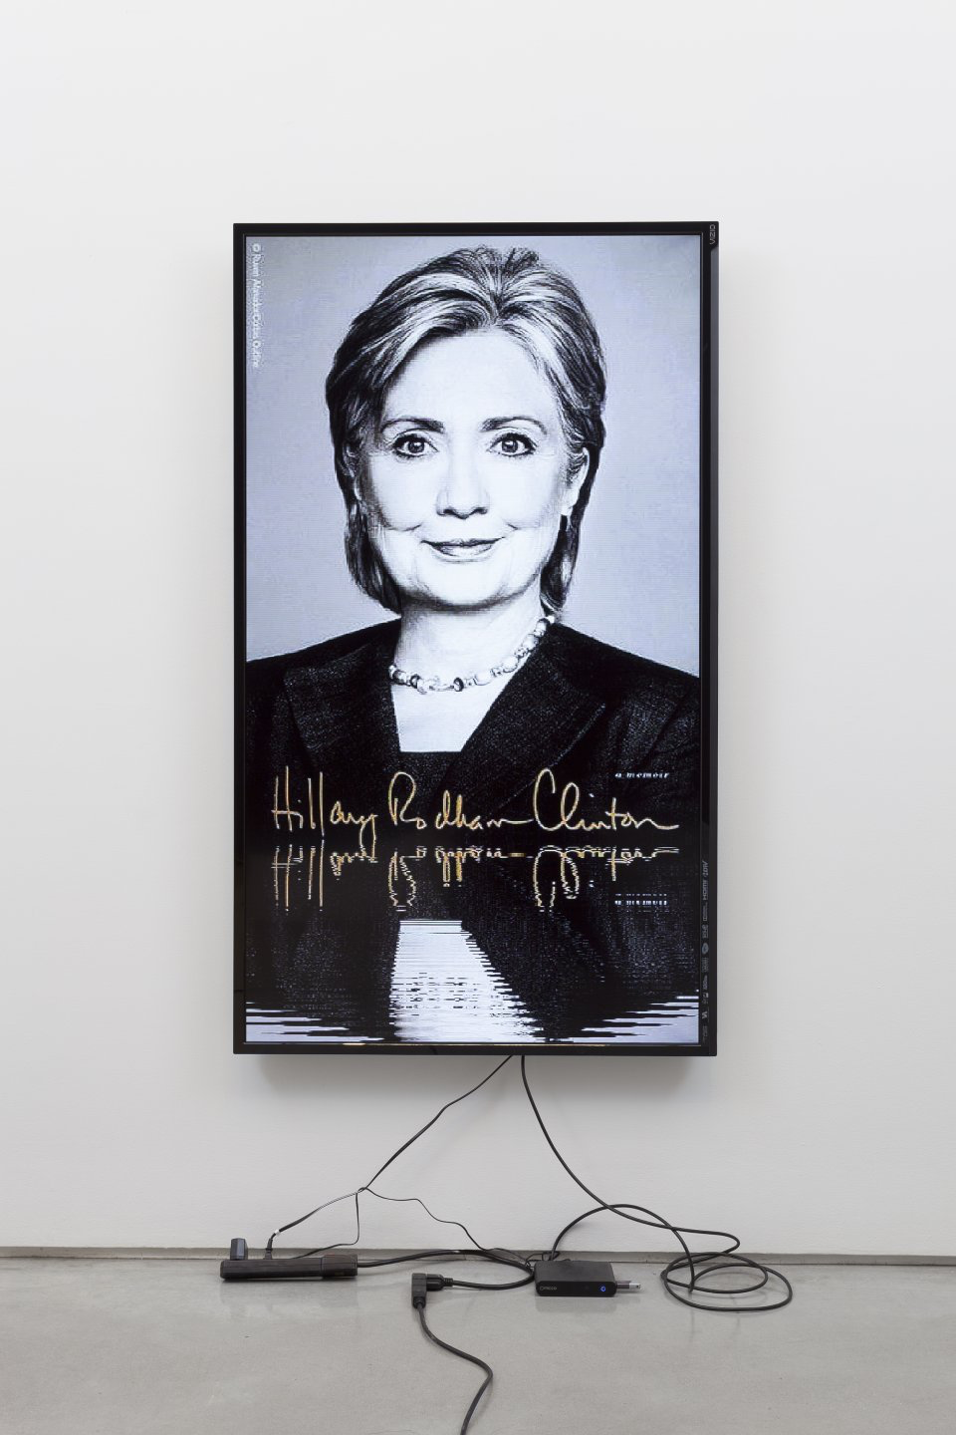

Slide 13
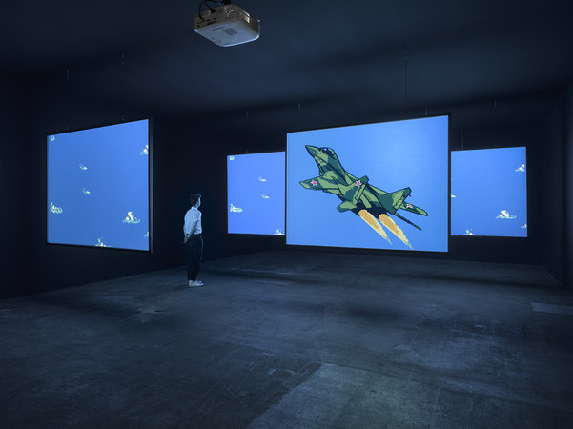
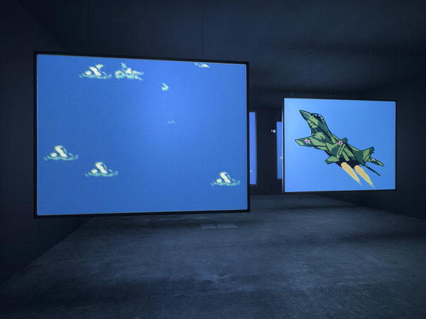

Slide 14
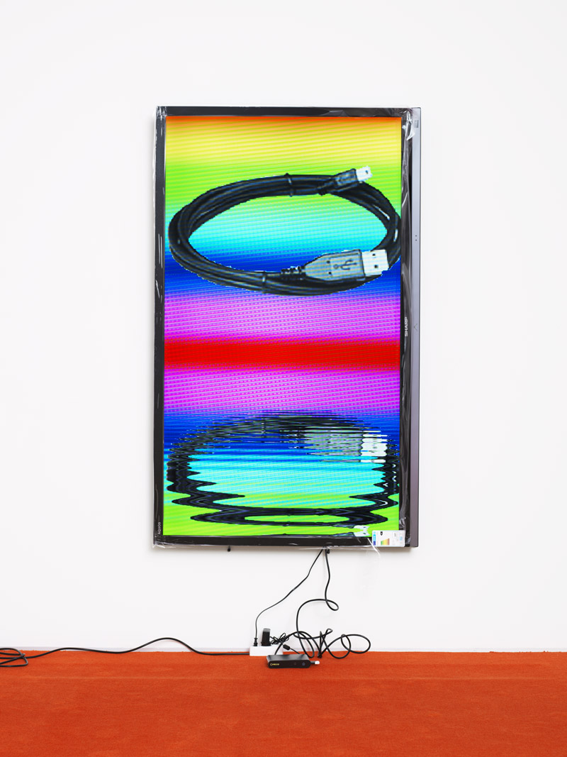

Slide 15
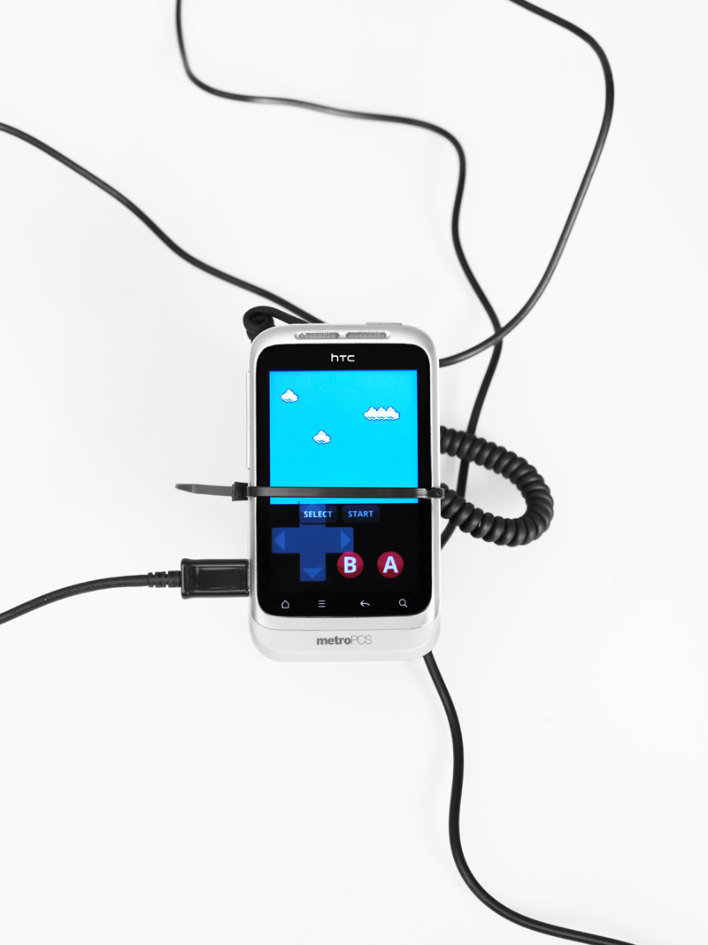
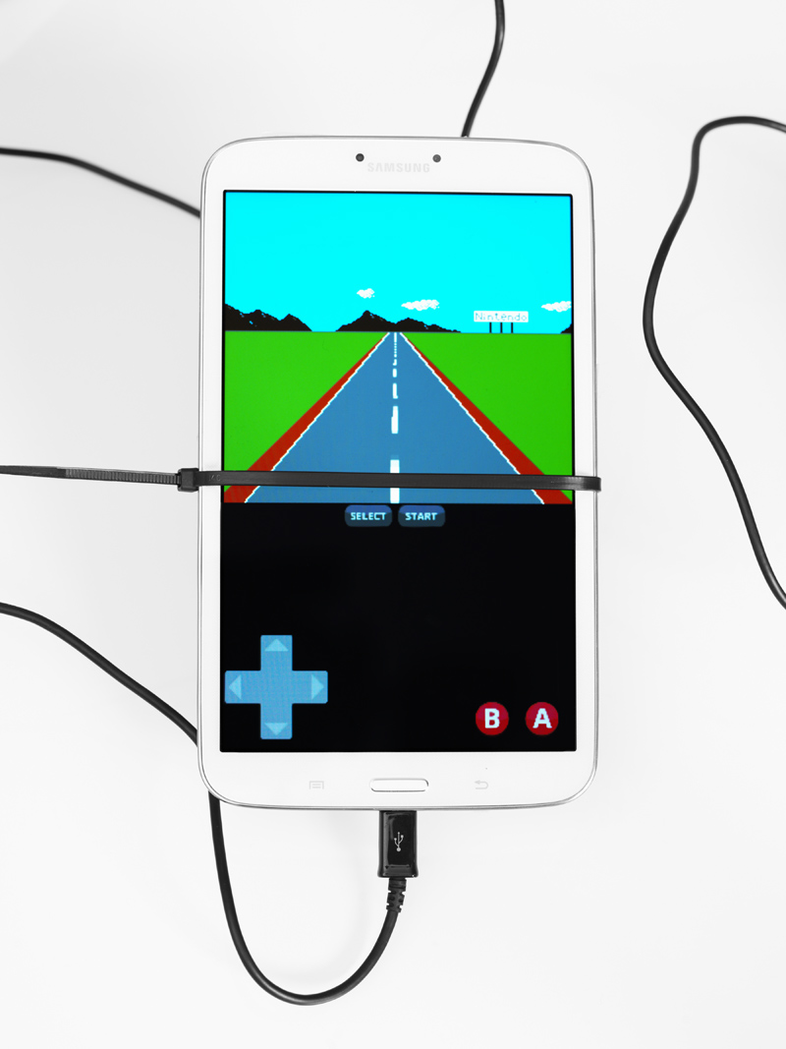

Slide 16
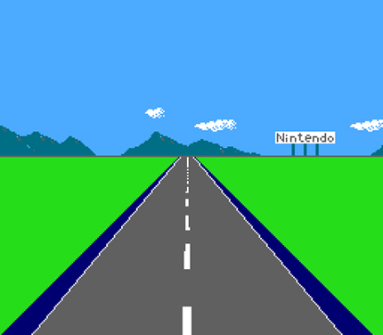
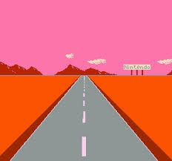

Slide 17
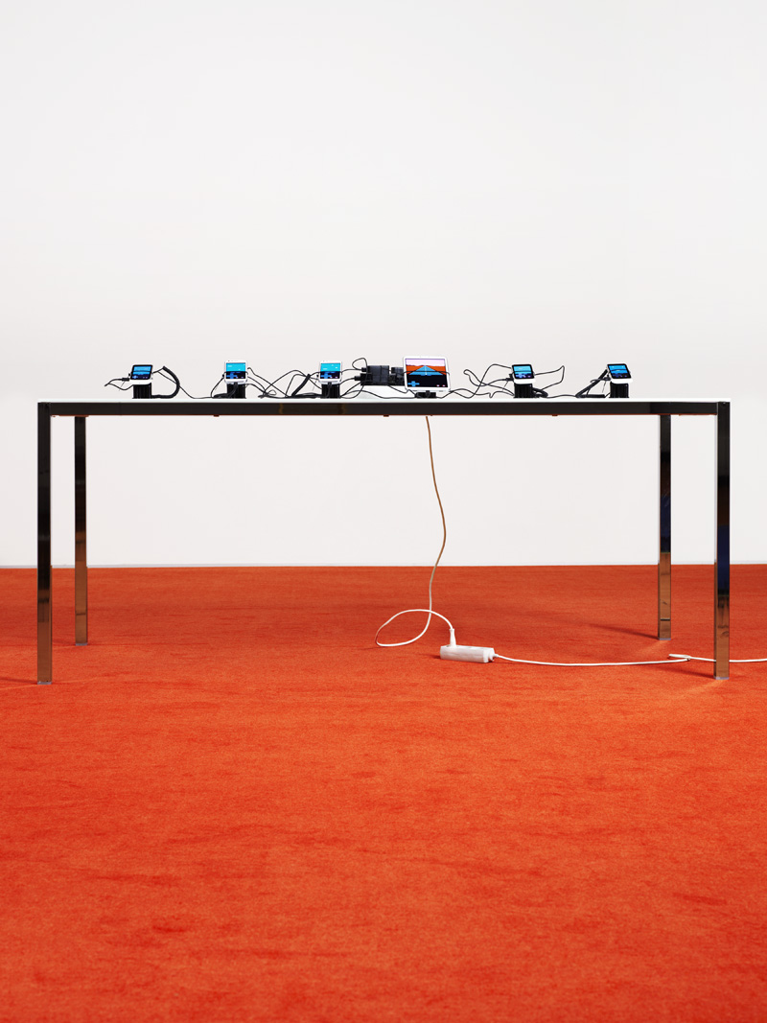

Slide 18
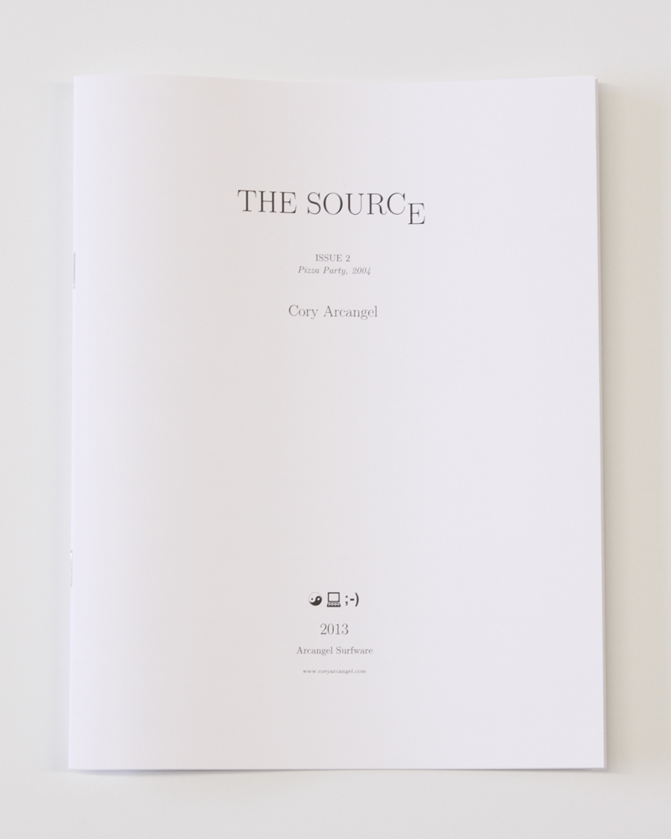

Slide 19
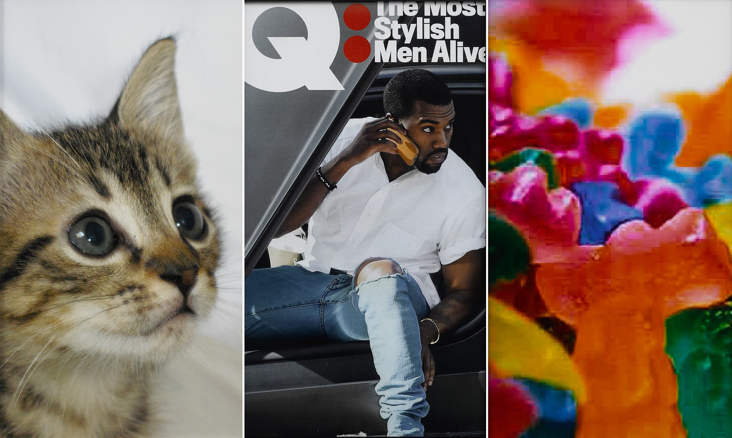

Slide 20
Thank You

Slide 21
Cory Arcangel is a Brooklyn, New York post-conceptual artist who makes work in many different media, including drawing, music, video, performance art, and video game modifications, for which he is best known. Arcangel often uses the artistic strategy of appropriation, creatively re-using existing materials such as dancing stands, Photoshop gradients and YouTube videos to create new works of art. His work explores the relationship between digital technology and pop culture.
“To answer your other question, I decided that hacking was art when I saw my first “cracker” tag. Meaning the screen a person put on a program they have cracked. After that I was obsessed with computer hacking and spent like a year learning how to program and how to reverse engineer programs. I was learning 68k Motorola Assembly then so I could play pranks on people at my school using Macintosh computers.
Arcangel's best-known works are his Nintendo game cartridge hacks and re workings of obsolete computer systems of the 1970s and 80s. One example is Super Mario Clouds (2002), which he first gained notice for. It is a modified version of the Super Mario Brothers video game for Nintendo, in which all of the game's graphics have been removed, leaving only a blue background with white clouds scrolling slowly from right to left.
The work was created on the basis of a manipulation of the hardware and software. Cory Arcangel had to open the cartridge, on which the game was stored, and replace the Nintendo graphics chip with a chip on which he had burned a program he had written himself. Cory Arcangel is a member of the Beige Programming Ensemble who have focused their artistic programme on the hacking ethic of manipulating existing technology, thereby taking the modification of legacy technology to absurd extremes:
Another fun Nintendo hack was ‘I Shot Andy Warhol’, a hacked version of the 1984 light gun game, Hogan's Alley. Players take on the role of feminist activist Valerie Solanas who once attempted to assassinate the Andy Warhol – the aim was to shoot him whenever he appears on screen, carefully avoiding other figures such as the pope, Colonel Sanders and Flavour Flav.
Typically Cory is grouped in with the appropriation artist movement that emerged in the 1980s, but he’s really more of a technology-based investigator with an interest in using available technology to do exactly what it does, in a recursive fashion

Slide 22
Another one of his works was Pizza Party (2004), which was a free, functional software package that could be used to order Domino's pizza through a command-line interface. The program allowed users to order pizza by typing in commands such as pizza_party_pmx 2 medium regular. The piece was commissioned by Eyebeam.
Five years ago, aged 33, he became the youngest artist since Bruce Nauman to be given a full-floor solo show at the Whitney museum in New York. That show brought together a number of software works in which Arcangel had hacked outmoded computing equipment and games.
In 2011, Cory had a show at the Whitney museum called Pro Tools, which was a show of new work. The bowling piece is called Various Self Playing Bowling Games. Featuring bowling games, he would modify them so they can only throw gutter balls over and over again. It is kind of a multi channel installation. Its similar to the Cloud’s piece in many, many ways. Its about repetition; the digital representation of the natural.
Arcangel has something of a hacker’s view of ownership. Some of his best-known works, are all available online as is the source code to recreate 2002’s Super Mario Clouds. In fact, he’s currently in the process of publishing The Source – an archive providing the code for all of his software works.
Trained as a classical guitarist, Arcangel had made witty coding and hacking his niche since mothballing his metronome to become an artist 15 years ago. “When I started making work, digital technology wasn’t mainstream,” he recalls. “These days everything comes through our phones – and it happened so quickly!” His new show, titled current mood is an attempt to address this digital world and the shifting status of the image within it. “My hope is it’s a show you could only make right now – it’s taking the temperature of 2016.”
All of the devices he uses to make work are all functional in themselves or are designed to make functional objects. However, the work that he makes is distinctly non-functional, and it makes use of the essence of the mechanics. So he’s drawing attention to the way things are made, why they are made, the arbitrary nature of the products that surround us and the absurdity of the mass culture that we live in

